Slide 1



Department of Artificial Intelligence Practical Examination Winter 2023 (Session: 2023-2024)
Group Number:- 11
Date : 15/12/2023
Title of the Project:- Sign Language Interpreter
Presented By:
Guide
Prof. Madhuri Sahu
Assistant Professor GHRCE , Nagpur
Shrikant Khawshe (B-34)
Vedanshu Thune (B-47)
Yash Mankar (B-51)
Yogvid Wankhede (B-53)

Slide 2

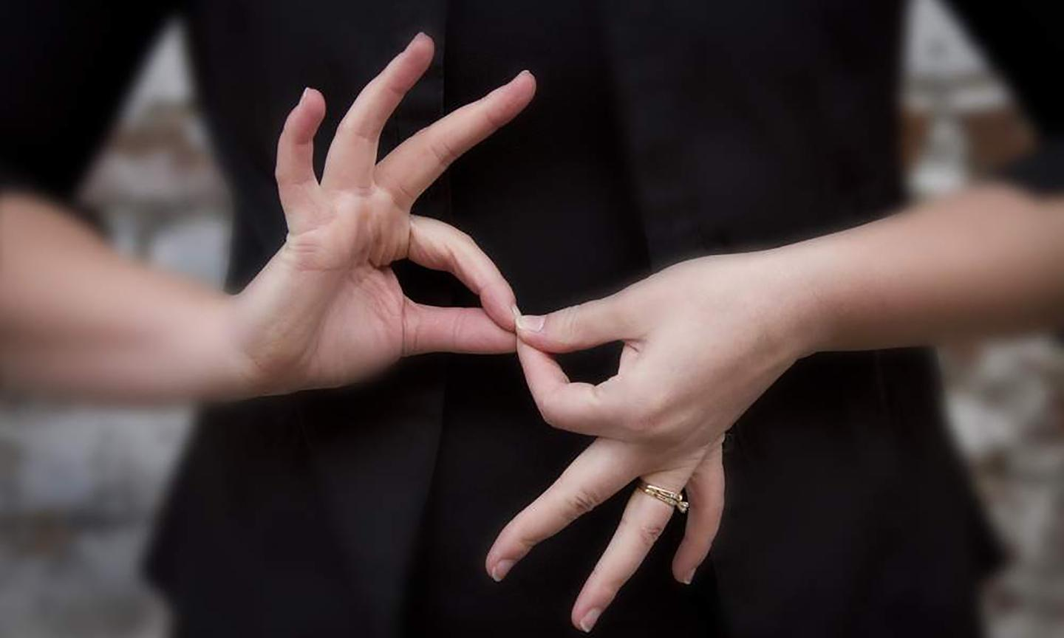

Sign Language Interpreter

Slide 3

Introduction
This project focuses on implementing a practical solution for sign language recognition and its interpretation. Sign language serves as a crucial form of communication for individuals with hearing impairments, but the language barrier between sign language and spoken language can hinder effective interaction. To address the problem, we propose a system that leverages a Dynamic Time Warping s and MediaPipe for real-time sign language to speech interpretation .
The project can be divided into two key phases:
Sign Language Recognition: It involves recognizing and comprehending signs and movements. It involves applying computer vision algorithms to classify the detected signs from visual data, such as video or pictures.
Speech Interpretation: Speech interpretation involves converting sign language into a spoken language, enabling individuals with hearing impairments to understand and communicate effectively.
The project highlights integrating MediaPipe, so that we can accurately detect and classify hand signs, enabling the system to identify the corresponding sign being performed. Dynamic Time Warping on large sign language dataset available on the Government Website as well as our own data, translates these recognized signs into spoken language. Also, the proposed model could be trained through the user created dataset.

Slide 4
Project Description
Objective: To bridge the communication gap between individuals who use sign language and those who rely on spoken language by accurately recognizing sign language or signs and then translating them into spoken language, we aim to facilitate effective means of communication.
Scope: The scope of the discussed project encompasses the practical implementation of sign language recognition and interpretation to speech using an Dynamic Time Warping and MediaPipe. The project aims to create a system that can accurately recognize and interpret sign language signs in real-time and convert them into spoken language.
Benefits: For those who have hearing loss, sign language is an essential form of communication that enables them to express their thoughts, ideas, and feelings. Also, effective communication between the deaf and normal communities could be hindered by the linguistic barrier between spoken language and sign language. Thus, innovative approaches that take advantage of recent developments in machine learning and computer vision are needed to close this gap.

Slide 5

Abstract
This study presents a practical implementation of sign language recognition and interpretation to speech, using the MediaPipe framework and Dynamic Time Warping (DTW) algorithm. MediaPipe offers real-time hand tracking and sign recognition capabilities, while DTW is a powerful method for recognizing and matching sign language. During runtime, the algorithm matches the user's signed gestures with these reference templates, allowing for the interpretation of sign language phrases and sentences. By integrating MediaPipe, the system enhances the precision of sign tracking, allowing for real-time analysis and interpretation. Accurate recognition of signs and their translation into spoken language facilitate effective communication and foster understanding between the deaf and hearing communities. Inclusivity and accessibility are paramount in this project, as we aim to empower individuals with hearing impairments through technology. By breaking down communication barriers, we strive to promote a more inclusive society. This practical implementation highlights the potential of machine learning and computer vision in revolutionizing sign language interpretation.

Slide 6
Literature Survey (Survey of existing products)
S. N | Title and Author | Published in | Year | Methodology | Conclusion
1. | “Research and Improvement of Chinese Sign Language Detection Algorithm Based on YOLOv5s” by Yifan Zhang, Ling Long, Diwei Shi, Haowen He, and Xiaoyu Liu | 2nd International Conference on Networking, Communications and Information Technology (NetCIT) | 2022 | The researchers focus on enhancing the detection algorithm for Chinese Sign Language using the YOLOv5s model. Their objective is to improve the accuracy and efficiency of sign language detection to bridge the communication gap between the deaf and hearing communities in China. | The results show that the improved model can achieve a detection accuracy of 96.50% which is better than the YOLOv5s.
2. | “Realtime Sign Language Detection and Recognition” by Aakash Deep, Aashutosh Litoriya, Akshay Ingole, Vaibhav Asare, Shubham M Bhole, and Shantanu Pathak. | 2nd Asian Conference on Innovation in Technology (ASIANCON) | 2022 | The real-time sign language recognition system is developed for recognizing the signs of Indian Sign Language (ISL). For recognizing the signs, the Regions of Interest (ROI) are identified and tracked using the skin segmentation feature of OpenCV using LSTM. | The system was able to detect and recognize a variety of sign language signs, including basic signs, compound signs, and fingerspelling with an overall accuracy of 94%

Slide 7
Literature Survey (Survey of existing products)
3. | “Dynamic Sign Language Recognition and Emotion Detection using MediaPipe and Deep Learning” by Dhruvin Gandhi, Kushal Shah and Madhav Chandane | 13th International Conference on Computing Communication and Networking Technologies (ICCCNT) | 2022 | This paper proposes a dynamic sign language recognition and emotion detection (DSLRED) model that uses MediaPipe’s holistic pipeline along with an LSTM network which also classifies the emotion on a person’s face into one of seven categories, using deep convolutional neural networks. | Proposed model achieved an accuracy of 98.95% and can effectively convey emotions and sentences in sign language, independent of the signer who performed the actions in the training data.
4. | “Imperative Methodology to Detect the Palm signs (American Sign Language) using YOLOv5 and MediaPipe” by Gouri Anilkumar, M S Fouzia, and G S Anisha | 2nd International Conference on Intelligent Technologies (CONIT) | 2022 | This research investigates two well-known models for recognizing American Sign Language signs for alphabets: MediaPipe-LSTM and YOLO v5-PyTorch. They were given custom datasets and the outcomes were inferred and compared to see how accurate and effective the models were. | The study concluded that YOLOv5 model was faster model with an accuracy of 95.5% and had certain edge over the MediaPipe-LSTM model.

Slide 8
Literature Survey (Survey of existing products)
5. | “Real-Time Translation of Sign Language for Speech Impaired” by Aishwarya D Shetty, Jyothi Shetty, Karthik K, Rakshitha, and Shabari Shedthi B | 7th International Conference on Computing Methodologies and Communication (ICCMC) | 2023 | In this study, LSTM networks classify speech-impaired users' sign language signs via real-time computer vision, coupled with deep neural networks and edge detection for hand recognition. Training employs holistic key points from videos capturing pose, facial features, and hand landmarks. | Proposed model can predict with an accuracy of 90%, showing the feasibility of using LSTM-based neural networks for the purpose of sign language translation.
6. | “Recognition of Indian Sign Language (ISL) Using Deep Learning Model” by Sakshi Sharma and Sukhvinder Singh | Wireless Personal Communications An International Journal -Springer | 2022 | The authors propose a deep learning approach for recognizing Indian Sign Language (ISL). The approach uses a convolutional neural network (CNN) to extract features from the hand images, and then a long short-term memory (LSTM) network to classify the hand signs. | The approach achieves an accuracy of 92.43% on a test set of hand images. This was significant improvement over previous approach to ISL recognition

Slide 9
Literature Survey (Survey of existing products)
7. | “Sign Language Recognition using Machine Learning Algorithm” by N Rajasekhar, M Geetha Yadav, Charitha Vedantam, Karthik Pellakuru, Chaitanya Navapete | International Conference on Sustainable Computing and Smart Systems (ICSCSS) | 2023 | The authors propose a machine learning approach for recognizing sign language. The approach uses a support vector machine (SVM) classifier to classify the hand signs. | The approach achieves an accuracy of 89.09% on a test set of 1000 hand images. This is a significant improvement over previous approaches to sign language recognition.
8. | “Sign Language Detection and Recognition using CNN” by B. V. Chowdary, Ajay Purshotam Thota, Alwa Sreeja, Kotla Nithin Reddy, and Karanam Sai Chandana | International Conference on Sustainable Computing and Smart Systems (ICSCSS) | 2023 | The authors propose a convolutional neural network (CNN) approach for detecting and recognizing sign language. The approach first uses a CNN to detect the hands in the image, and then another CNN to recognize the sign language signs. The CNN used in the approach has 10 convolutional layers and 3 fully connected layers. | The approach achieves an accuracy of 90.2% on a test set of the images using the proposed CNN.

Slide 10
Literature Survey (Survey of existing products)
9. | "Indian Sign Language recognition system using SURF with SVM and CNN" by Shagun Katoch, Varsha Singh, and Uma Shanker Tiwary | International Journal of Trend in Scientific Research and Development (IJTSRD) | 2022 | This paper proposes a system for recognizing Indian Sign Language (ISL) alphabets and digits using Speeded Up Robust Features (SURF) with Support Vector Machines (SVM) and Convolutional Neural Networks (CNN). The system first segments the hand from the background, then extracts SURF features from the hand region, and finally classifies the features using SVM or CNN. | The system achieved an accuracy of 92% on the dataset. The authors also noted that the system is able to recognize ISL signs in real time.
10. | “Motion Based Indian Sign Language Recognition using Deep Learning” by Atharv Ganpatye and Sunil Mane | 2nd International Conference on Intelligent Technologies (CONIT) | 2022 | This paper proposes a system for recognizing Indian Sign Language (ISL) signs using deep learning. The system first segments the hand from the background, then extracts motion features from the hand region, and finally classifies the features using a deep learning model. | The approach achieves an accuracy of 92% on a test set of the images using the proposed methodology.

Slide 11
Proposed Methodology/System Architecture
Building a sign language detection model using DTW and MediaPipe involves several steps, from data collection to model evaluation. Here's a proposed methodology to guide you through the process:
Data Collection: Gather a diverse dataset of sign language signs with corresponding labels, including video recordings of different users performing various signs.
Holistic Model and Landmark Extraction:
Utilize the Holistic Model of MediaPipe to extract keypoints from Hands, Pose, and Face models.
For this project, focus primarily on the Hand model to predict sign language gestures.
In cases where a hand is not detected, set all positions to zero as a baseline.
Hand Feature Extraction:
Create a HandModel class to define the hand gesture at each frame.
To ensure invariance to orientation and scale, design a feature vector comprising a list of angles between connections of the hand's landmarks.

Slide 12
Proposed Methodology/System Architecture
Sign Model with Landmarks:
The SignModel class is constructed using a list of landmarks extracted from video frames.
For each frame, store the feature vectors of each hand, representing their respective hand gestures using the calculated angles.
Sign Recorder:
Implement the SignRecorder class to store HandModels for both left and right hands at each frame during recording.
Upon completion of the recording, compute the Dynamic Time Warping (DTW) distance between the recorded sign and reference signs present in the dataset.
Add a voting logic that only outputs a result if the prediction confidence is higher than a predefined threshold.
Dynamic Time Warping (DTW):
Utilize DTW, a widely accepted technique for measuring time series similarity.
In this project, compute the DTW distance specifically for the variation of hand connection angles over time.
The DTW algorithm allows for the comparison of the user's sign gestures (represented by their angle variations) with reference signs in the dataset.

Slide 13
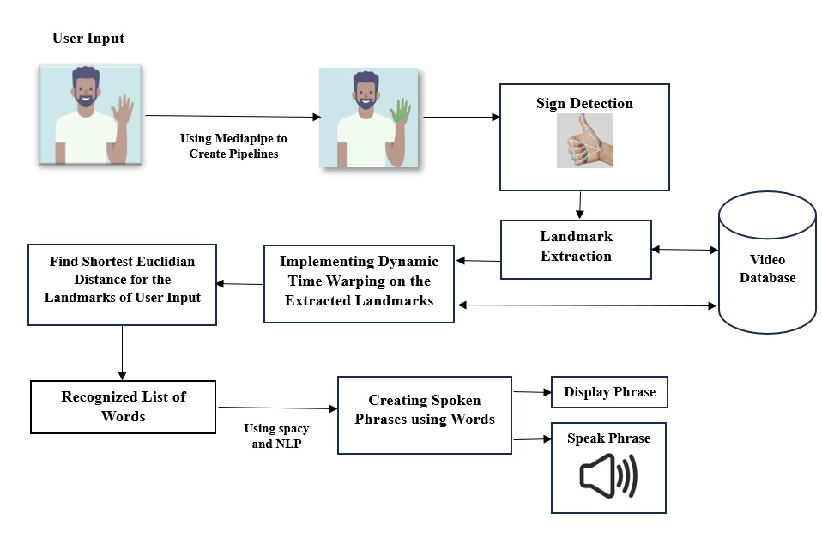
Proposed Methodology/System Architecture
Fig.1: Model Architecture

Slide 14
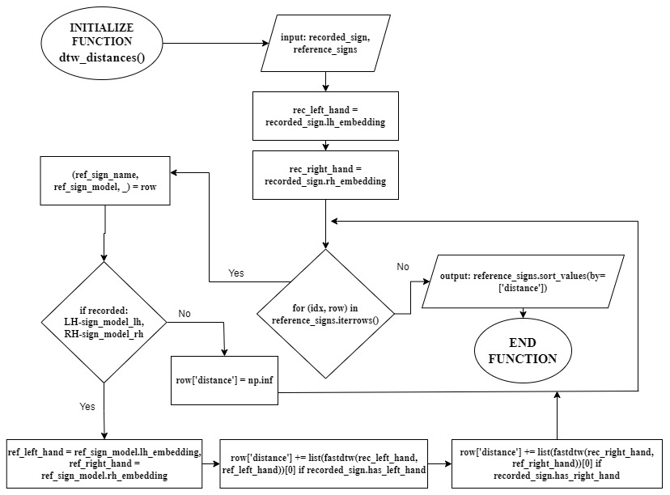
Proposed Methodology/System Architecture
Fig.2: Calculating DTW Distance

Slide 15
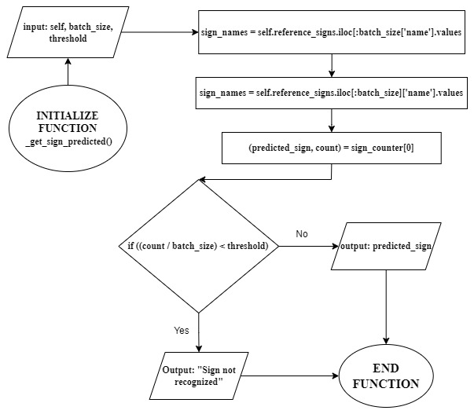
Proposed Methodology/System Architecture
Fig.3: Predicting the Sign

Slide 16
Hardware /Software Specification
Language:
Python
Domain:
Computer Vision
Machine Learning
Libraries:
OpenCV
Tensorflow Keras
MediaPipe
Dynamic Time Warping
NLP
pyttsx3

Slide 17
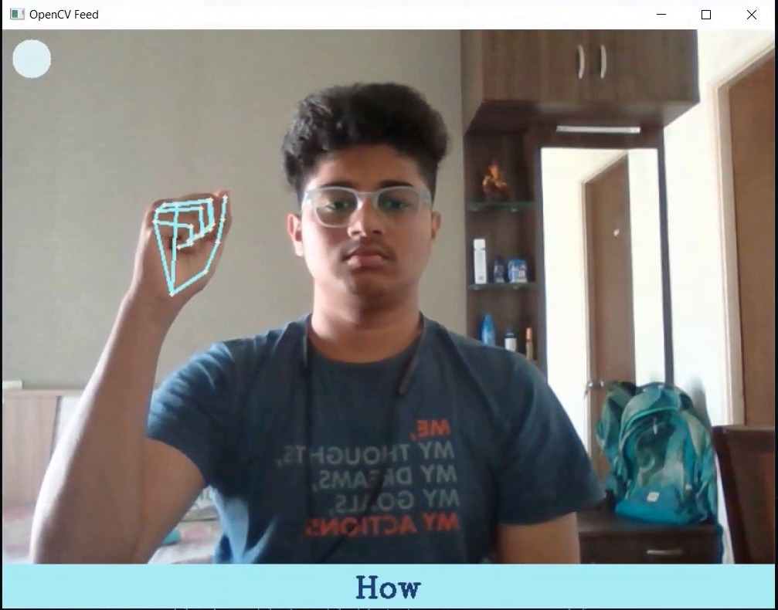
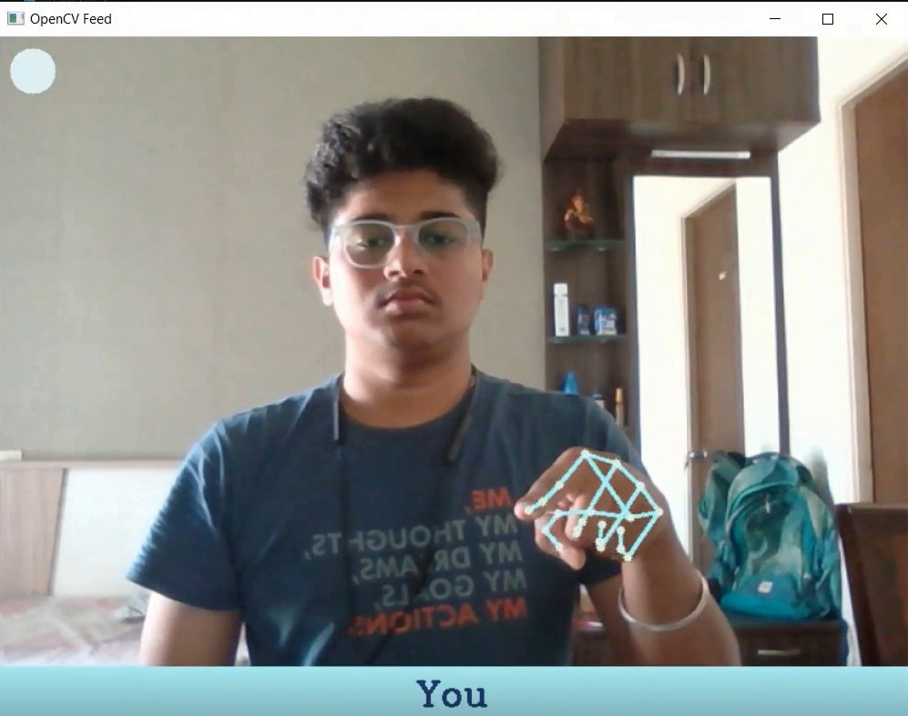
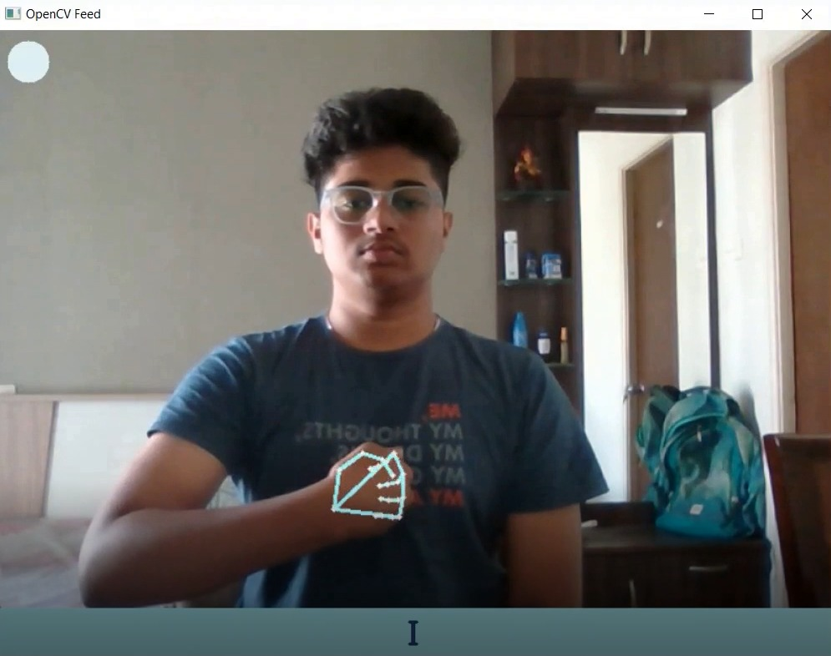
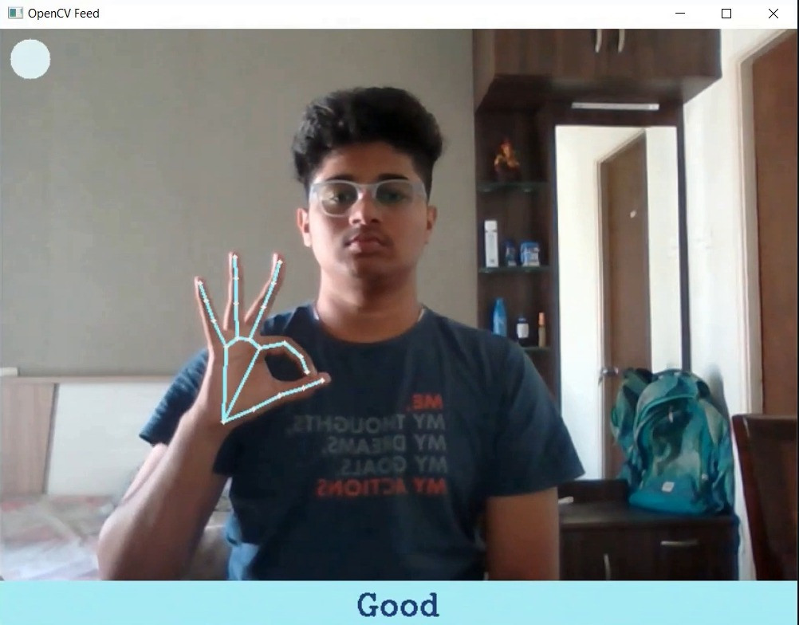
Implementation
These demonstrates real-time sign language recognition using Dynamic Time Warping and Mediapipe for sentences:
Predicted Sentence
How are You?
I am Good

Slide 18
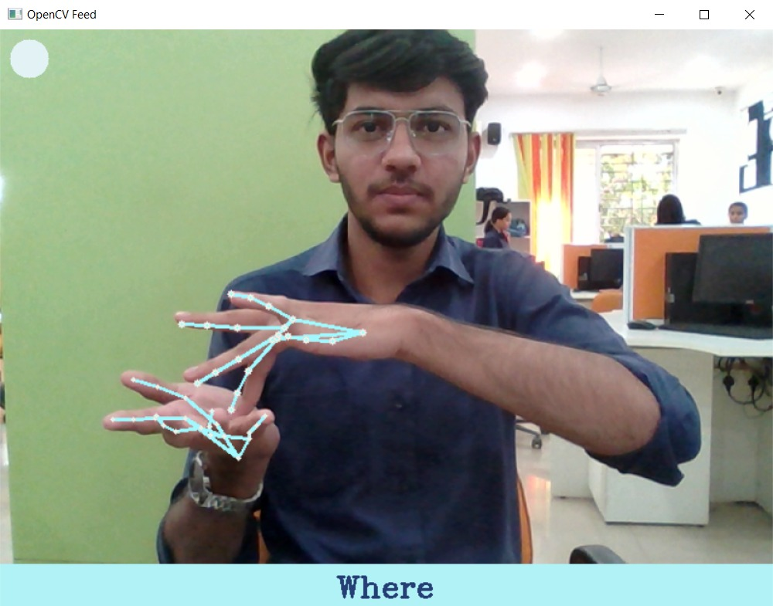
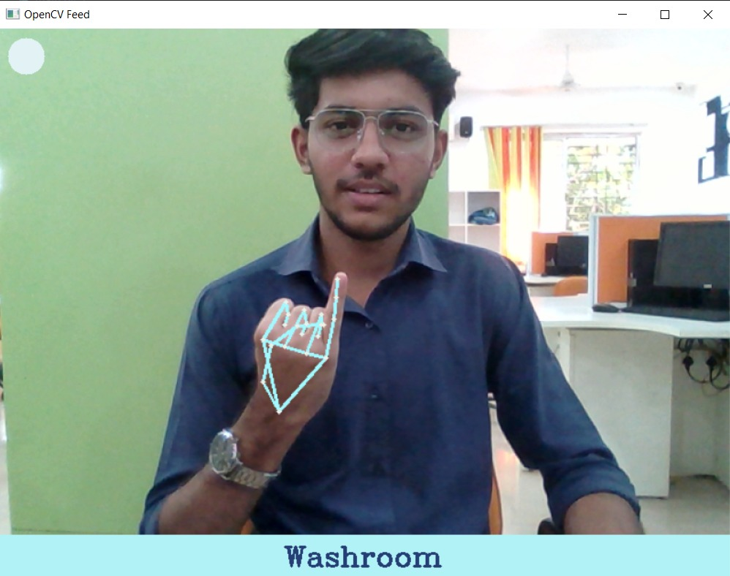
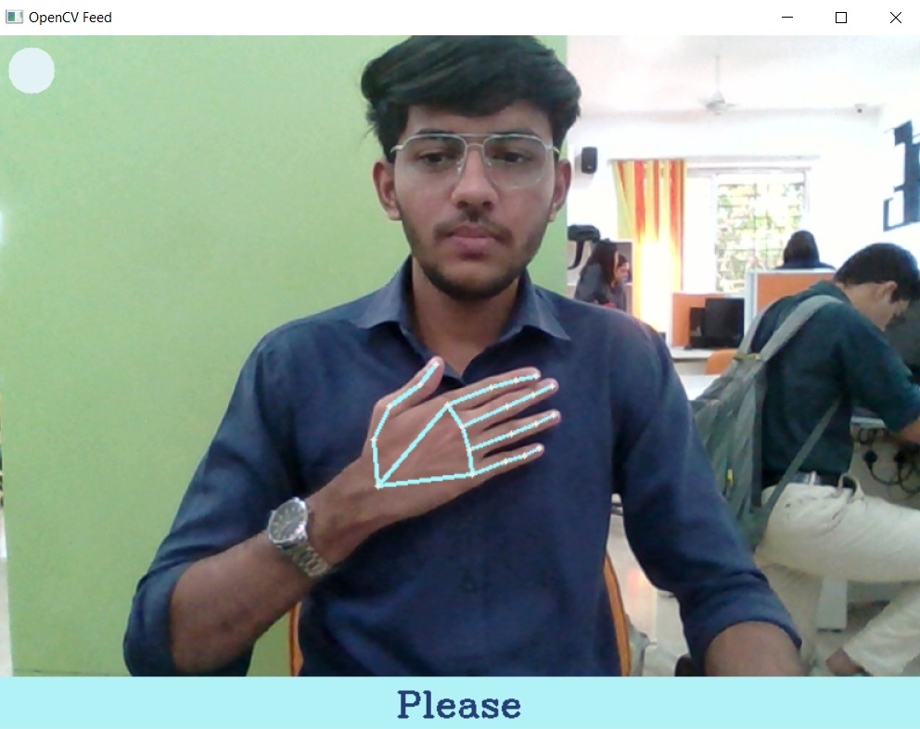
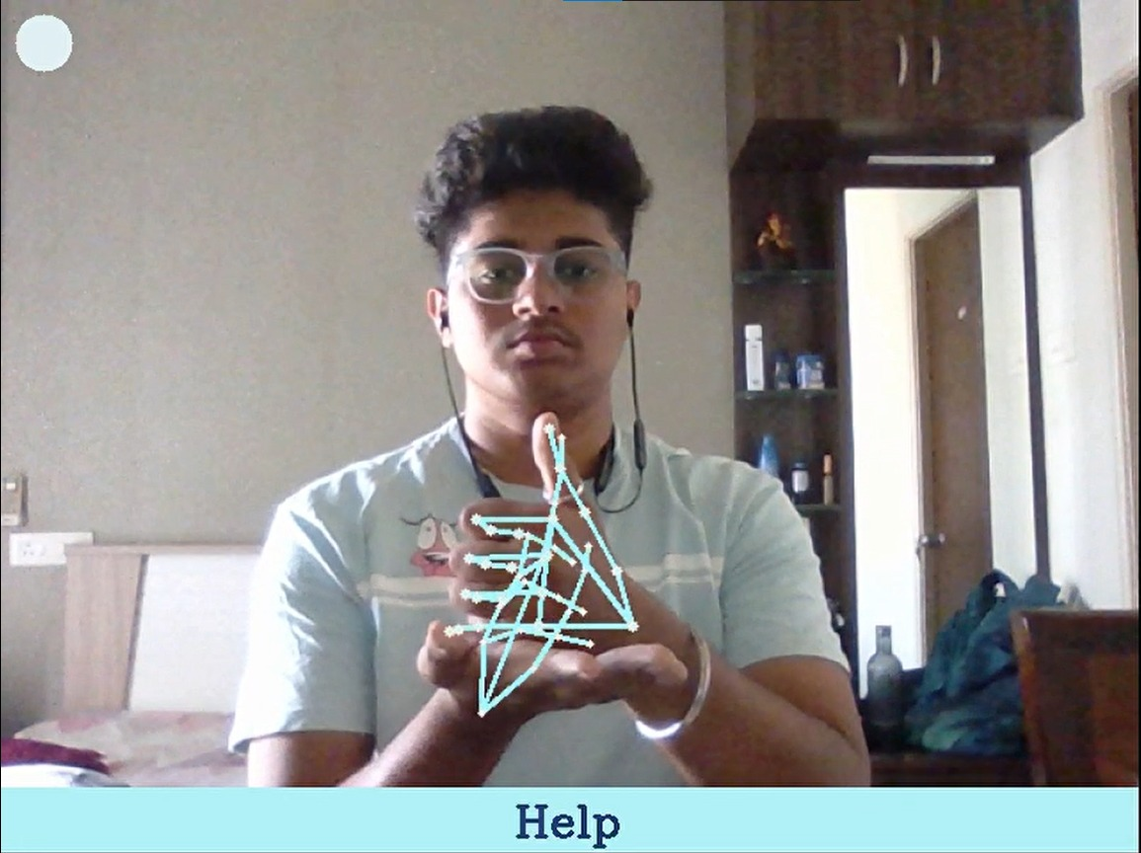
Implementation
These demonstrates real-time sign language recognition using Dynamic Time Warping and Mediapipe for sentences :
Predicted Sentence
Where is Washroom?
Please Help!

Slide 19
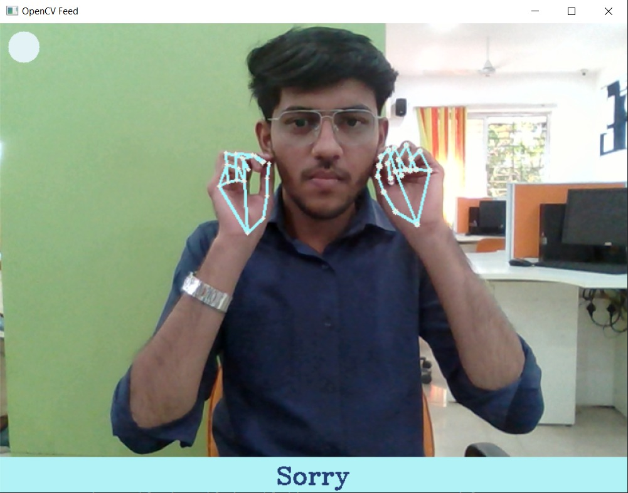
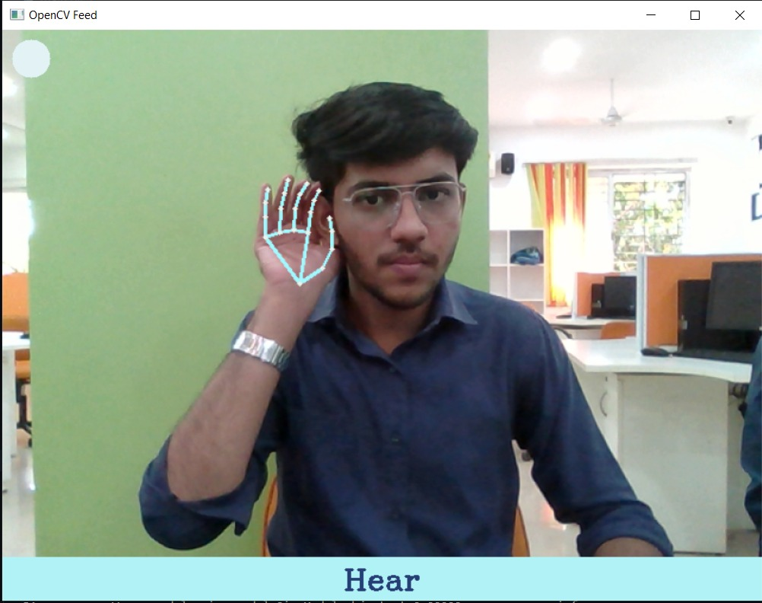
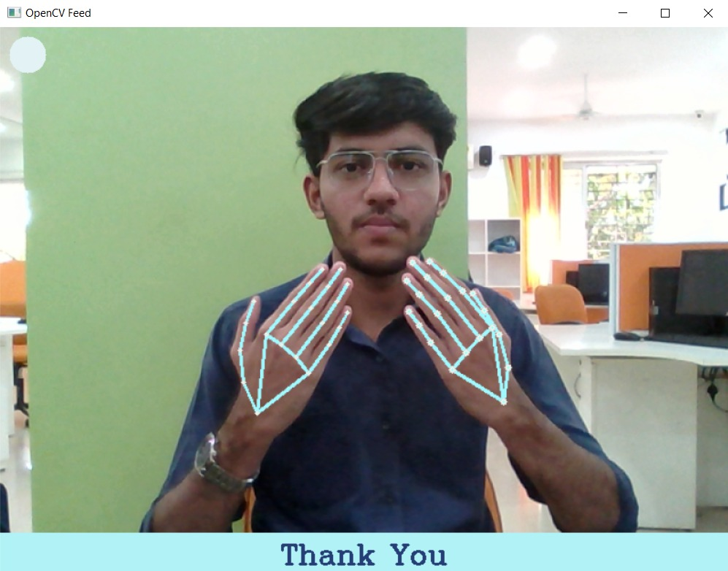
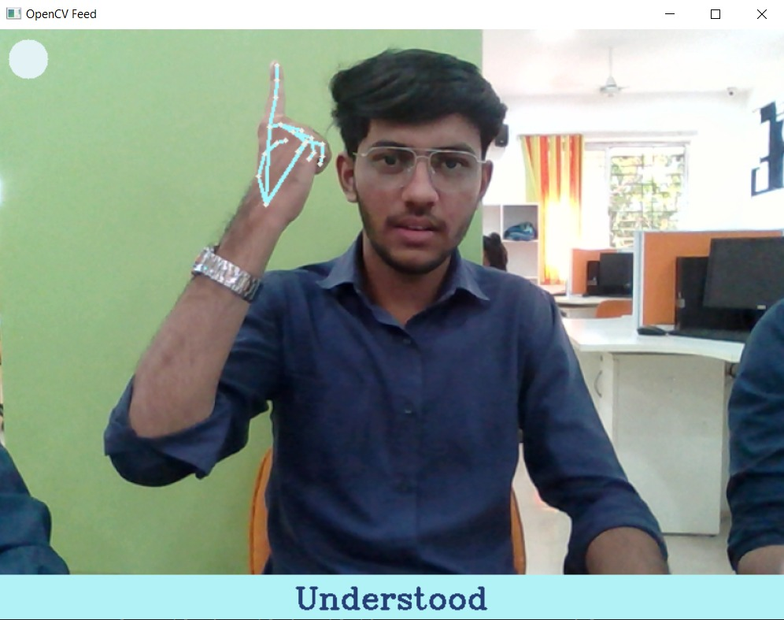
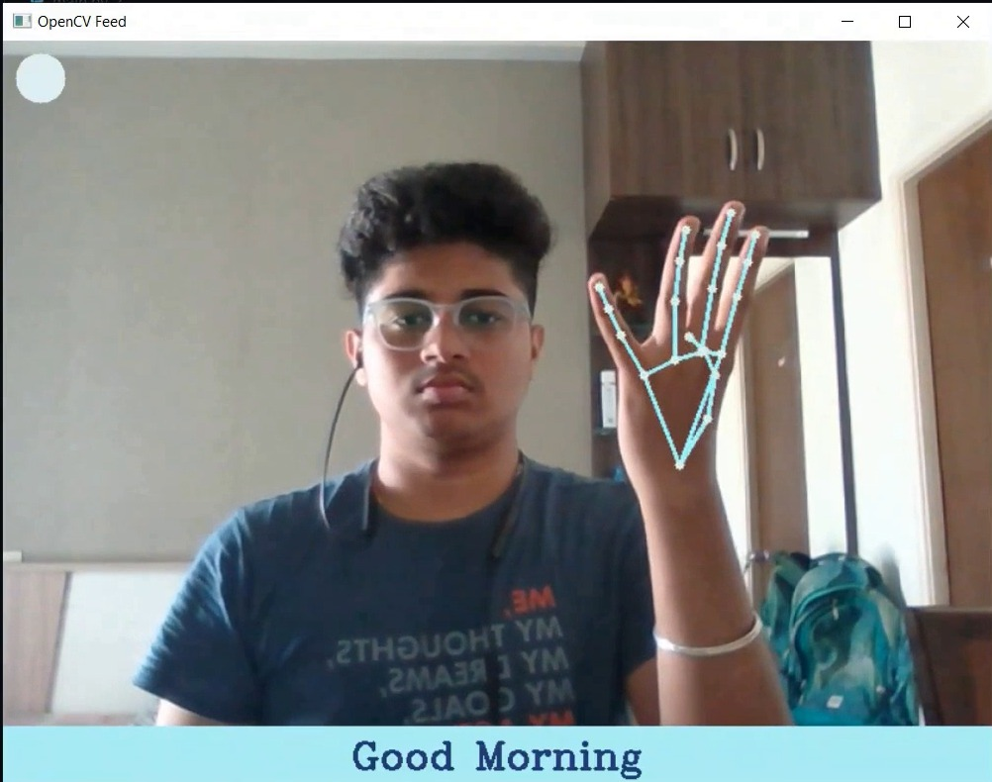
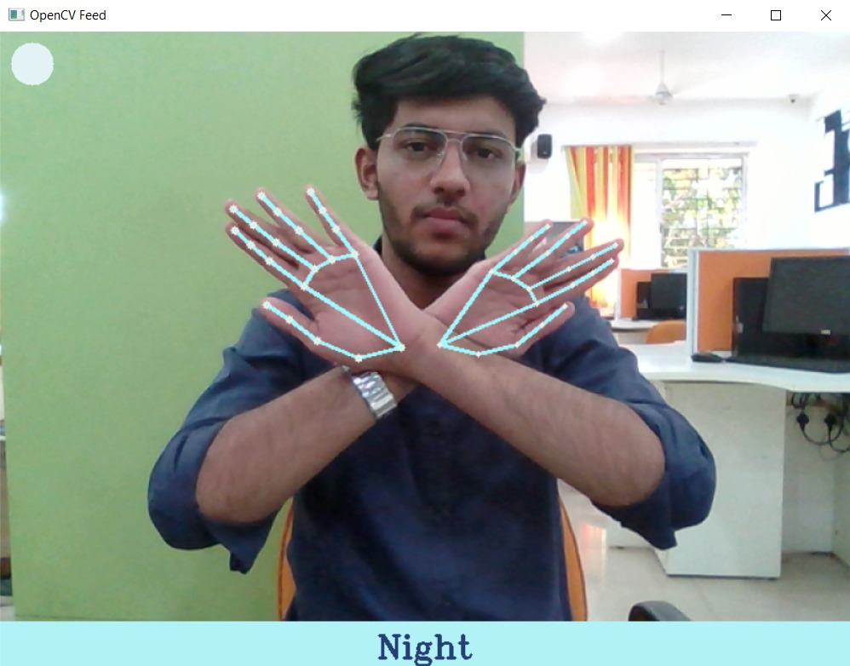
Implementation
These demonstrates real-time sign language recognition using Dynamic Time Warping and Mediapipe for words and greetings :

Slide 20

Result
In this section, we discuss the recognition ability of the proposed model in terms of accuracy and complexity. The accuracy and complexity of the two approaches used for recognition were compared. The first method used Long Short-Term Memory (LSTM) for recognition, and the other used Dynamic Time Warping. The model in which recognition was performed using LSTM required a large amount of data for each sign to work efficiently. To train an LSTM model, we must run iterative epochs, and the time required to complete these epochs depends on the size of the dataset and the computational power of the system. Thus, the LSTM model had worse time and space complexity. However, the model in which DTW was used for recognition required less data as it compared the similarity between the two signs. This model is more accurate and had less time and space complexities. Based on the observations, we obtained an accuracy of 81.6% for LSTM model. However, we obtained a better accuracy of 93.3% using DTW and Mediapie model.

Slide 21
Conclusion
In conclusion, this project intends to successfully demonstrate a practical implementation of sign language recognition and interpretation to speech using Dynamic Time Warping and MediaPipe. By leveraging advancements in computer vision, we have developed a system that accurately detects and classifies sign language signs in real-time, enabling seamless interpretation into spoken language.
Through the integration of MediaPipe, our system achieves precise sign tracking, enhancing the accuracy and robustness of sign language recognition. The Dynamic Time Warping, implemented on extensive sign language datasets, ensures context-aware and accurate translations of recognized signs into spoken language.

Slide 22
Future Scope
Expansion of Sign Language Vocabulary: The project can be extended to include a larger vocabulary of sign language signs, encompassing a broader range of expressions and phrases. This would enhance the system's capability to interpret a wider variety of sign language and communications in different native languages.
Multilingual Translation: The system can be enhanced to support real-time translation of sign language into multiple spoken languages. By incorporating language models and translation algorithms, the system can cater to diverse linguistic needs, facilitating communication between sign language users and individuals who speak different languages.
Sign Recognition Refinement: Further research and development can focus on improving the accuracy and robustness of the sign recognition component. By refining the algorithms and training procedures, the system can better handle variations in hand shapes, movements, and signs, leading to more reliable sign language interpretation.
Integration with Mobile Devices: The project can be extended to develop mobile applications that run the sign language recognition and interpretation system. This would enable individuals to access the system on their smartphones or tablets, promoting convenience and accessibility in various settings.
Real-time Feedback and Correction: Implementing a feedback mechanism within the system can allow users to review and correct any misinterpretations or inaccuracies in the translation. This interactive feature can enhance the system's learning capabilities and further improve its accuracy over time.

Slide 23
Reference
Y. Zhang, L. Long, D. Shi, H. He, and X. Liu, "Research and Improvement of Chinese Sign Language Detection Algorithm Based on YOLOv5s” in Proceedings of the 2022 2nd International Conference on Networking, Communications and Information Technology (NetCIT)
A. Deep, A. Litoriya, A. Ingole, V. Asare, S. M. Bhole, and S. Pathak, "Realtime Sign Language Detection and Recognition” in Proceedings of the 2022 2nd Asian Conference on Innovation in Technology (ASIANCON)
D. Gandhi, K. Shah, and M. Chandane, "Dynamic Sign Language Recognition and Emotion Detection using MediaPipe and Deep Learning" in Proceedings of the 2022 13th International Conference on Computing Communication and Networking Technologies (ICCCNT)
G. Anilkumar, M. S. Fouzia, and G. S. Anisha, "Imperative Methodology to Detect the Palm signs (American Sign Language) using YOLOv5 and MediaPipe" in Proceedings of the 2022 2nd International Conference on Intelligent Technologies (CONIT)
A. D. Shetty, J. Shetty, K. K, R. Rakshitha, and S. S. B, "Real-Time Translation of Sign Language for Speech Impaired" in Proceedings of the 2023 7th International Conference on Computing Methodologies and Communication (ICCMC)

Slide 24
Reference
Sakshi Sharma and Sukhvinder Singh “Recognition of Indian Sign Language (ISL) Using Deep Learning Model” Wireless Personal Communications, An International Journal -Springer
N. Rajasekhar, M. Geetha Yadav, Charitha Vedantam, Karthik Pellakuru, Chaitanya Navapete, "Sign Language Recognition using Machine Learning Algorithm” in International Conference on Sustainable Computing and Smart Systems (ICSCSS)
B. V. Chowdary, Ajay Purshotam Thota, Alwa Sreeja, Kotla Nithin Reddy, and Karanam Sai Chandana, "Sign Language Detection and Recognition using CNN" in International Conference on Sustainable Computing and Smart Systems (ICSCSS)
Shagun Katoch, Varsha Singh, and Uma Shanker Tiwary, "Indian Sign Language recognition system using SURF with SVM and CNN" in International Journal of Trend in Scientific Research and Development (IJTSRD)
Atharv Ganpatye and Sunil Mane, "Motion Based Indian Sign Language Recognition using Deep Learning" in 2nd International Conference on Intelligent Technologies (CONIT)

Slide 25

Thank You!

